Slide 1
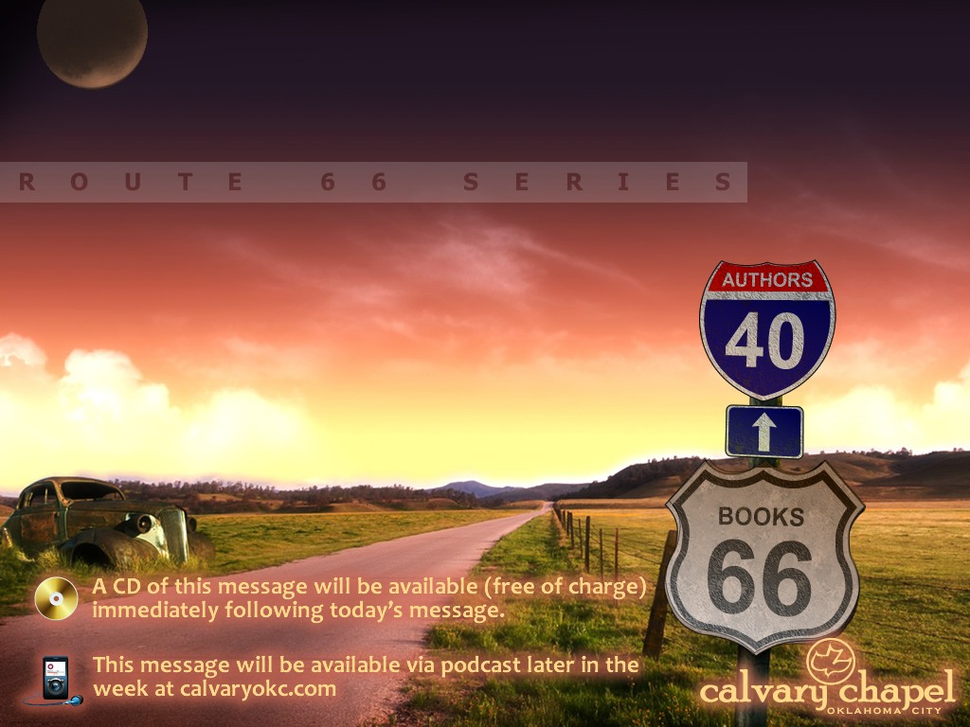
PHILIPPIANS

Slide 2
PHILIPPIANS
Joy ~ 4x
Rejoice, rejoicing, rejoiced ~ 12x
Glad, gladness ~ 3x

Slide 3
PHILIPPIANS
"Happiness depends on what happens. Joy does not."
Oswald Chambers

Slide 4
PHILIPPIANS
Originally called Krinides
Changed to Philippi by Philip I in 355 BC
Battle of Philippi, 42 BC
Marc Antony
and Octavian
Brutus and
Cassius
vs.

Slide 5
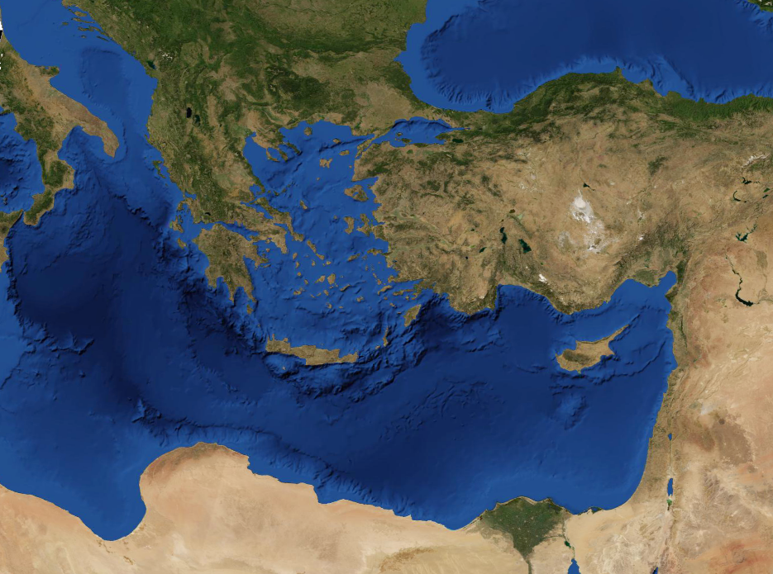
PHILIPPIANS
Rome
Philippi
Byzantium
Via Appia
Sea Route
Via Egnatia

Slide 6
PHILIPPIANS
Written from Rome
Tychicus ~ Ephesus
Epaphroditus ~ Philippi
Epaphras ~ Colossae
Onesimus ~ Philemon (Colossae)

Slide 7
PHILIPPIANS
Therefore He is also able to save to the uttermost those who come to God through Him, since He always lives to make inter-cession for them.
Hebrews 7. 25

Slide 8
PHILIPPIANS
If ~ condition of the 1st class (assuming the condition to be true)
i.e. ~ Since
Consolation ~ paraklēsis

Slide 9
PHILIPPIANS
One accord ~ sumpsuchoi
“With (one) soul”

Slide 10
PHILIPPIANS
Form ~ morphē

Slide 11
PHILIPPIANS
Made ~ kenoō – to make void, empty

Slide 12
PHILIPPIANS
Mutilation ~ katatomē (NASB, false circumcision)
Circumcision ~ peritomē

Slide 13
PHILIPPIANS
Euodia ~ good way
Syntyche ~ come together

Slide 14
PHILIPPIANS
"If you have no joy in your religion, there’s a leak in your Christianity somewhere."
Billy Sunday

